Slide 1
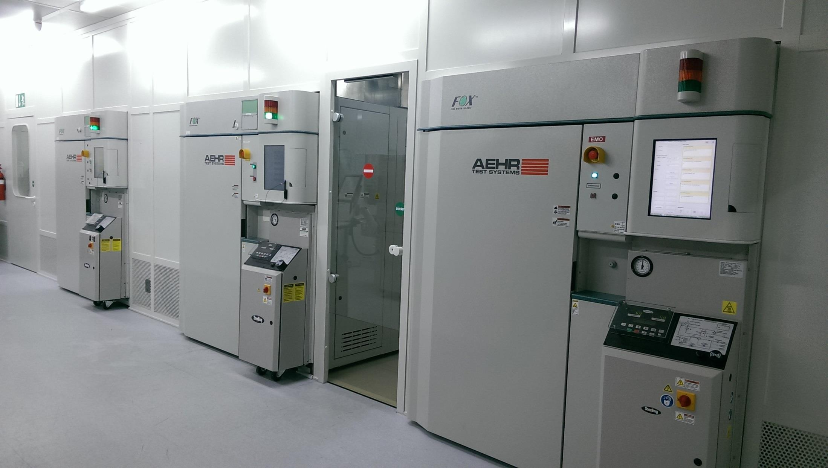


Setting the Test Standard for Tomorrow
Setting the Test Standard for Tomorrow
Nasdaq: AEHR
Nasdaq: AEHR

Slide 2
Forward Looking Statements
This presentation contains forward-looking statements that involve risks and uncertainties relating to projections regarding industry growth and customer demand for the Company’s products. Actual results may vary from projected results. These risks and uncertainties include without limitation, acceptance by customers of the ABTS™ and FOX™ technologies, the Company’s development and manufacture of a commercially successful wafer level burn-in and test system, world economic conditions, the timing of the recovery of the semiconductor equipment market, the Company’s ability to maintain sufficient cash to support operations, and the potential emergence of alternative technologies, which could adversely affect demand for the Company’s products in fiscal year 2021. See the Company’s recent 10-K and 10-Q reports filed with the SEC for a more detailed description of the risks facing the Company’s business. The Company disclaims any obligation to update information contained in any forward-looking statement to reflect events or circumstances occurring after the date of this presentation.

Slide 3
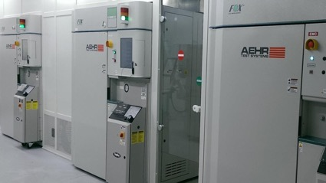
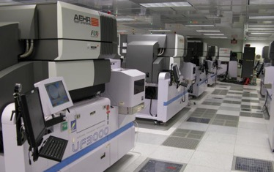
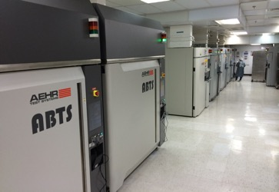
Company Overview
Worldwide supplier of burn-in test equipment and pioneer of wafer level burn-in (“WLBI”) platform
Leader in WLBI, stabilization, and infant mortality test which is being commercially adopted across multiple high-growth market segments
Aehr’s FOX wafer level and singulated die/module systems and consumables have been validated and adopted by Tier 1 customers for rapidly growing applications including Silicon Photonics, Silicon Carbide, and 2D & 3D Sensing
Developing next generation packaged part burn-in (“PPBI”) platform for high voltage, high power automotive and industrial applications
High margin proprietary WaferPak and DiePak consumables are a significant percentage of revenues
Ability to rapidly scale production in existing manufacturing footprint
In discussions with Memory Suppliers regarding next generation WLBI system for wafer level test during burn-in for Flash/DRAM (an upside opportunity not included in forecast)
Production Semiconductor Test & Burn-In for over 40 Years
Multiple Wafer / Die Level Test & Burn-In Solutions
Single Wafer Test & Burn-In Solutions
Packaged Part Test & Burn-In Solutions

Slide 4
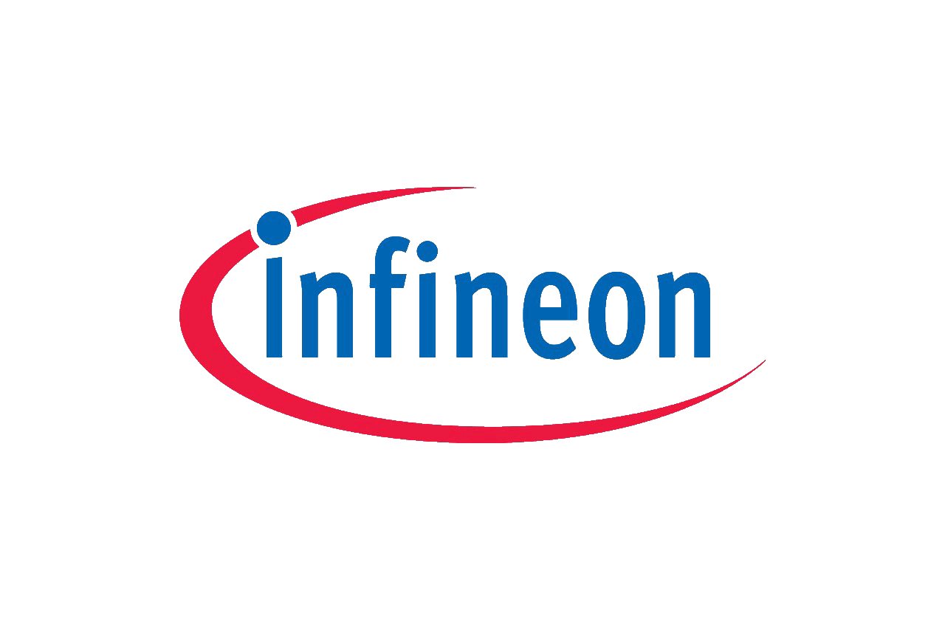







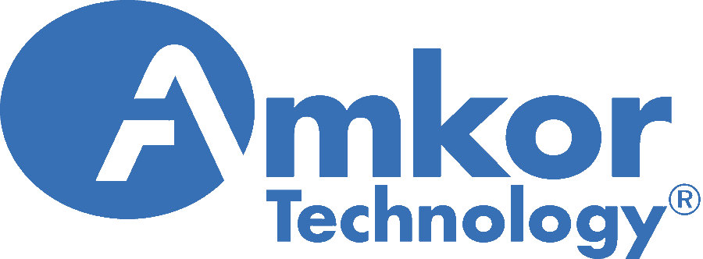























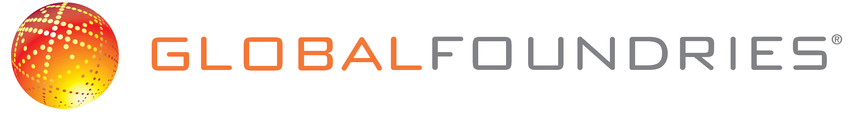
Worldwide Customer Base
Aehr has been a leader in burn-in test solutions for over 40 years with thousands of systems shipped worldwide
(Partial Customer List)

Slide 5

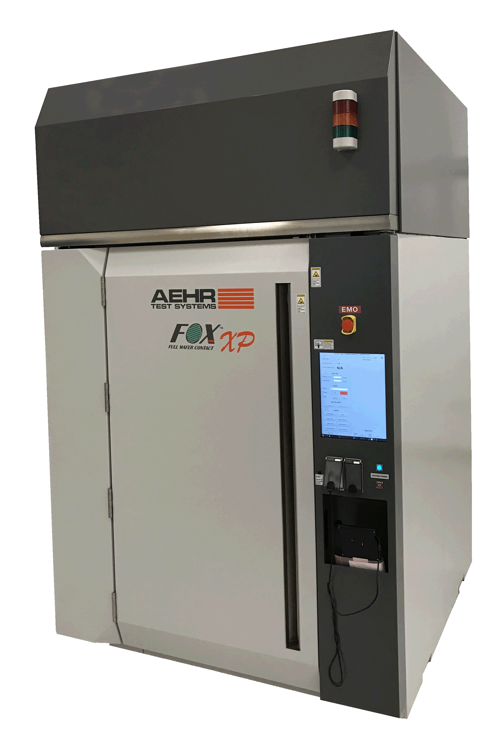
WLBI vs. PPBI Test Flow Example
Packaged Part Burn-In Test Flow
Die Test 1 | Die Test 2 | Packaging | Pkg Test 1 | PPBI | Pkg Test 2
Aehr Test FOX-XP
Die Test 1 with Burn-In | Die Test 2 | Packaging | Pkg Test 1 | Pkg Test 2
Wafer Level Burn-In Test Flow

Slide 6
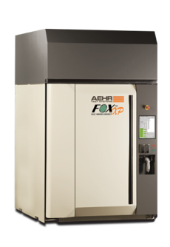

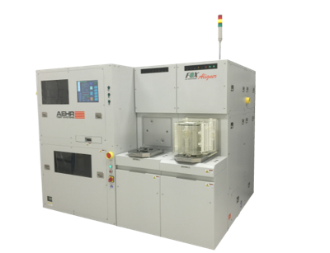
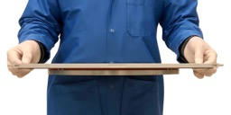
Wafer Level Enabling Technology
Aehr’s FOX-XP is capable of both functional burn-in and test solutions by leveraging proprietary aligner and contactor technology
Multi-wafer technology enables customers to achieve an overall decrease in test equipment cost and fab footprint, while increasing die yield and throughput
MULTI-WAFER TESTER
CONTACTOR
ALIGNER
FOX-XP Multi-Wafer
Test System
FOX-XP WaferPaks
FOX WaferPak
Aligner
May be configured with up to 18 Blades, enabling 18 wafers to be tested in parallel – driving cost efficiency and throughput
High performance thermal chucks allow uniform temperature control of the wafers
Footprint similar to single wafer automated test equipment – reducing lab test space
Houses the wafer and distributes signals and power to the wafer itself
The WaferPak contactor is capable of over 50,000 contacts in a single touchdown on up to 300mm wafers
Consumable input into the test system driving recurring revenue from the installed base
Integral piece of test cell as it loads the wafer in the WaferPak at immense levels of precision
By perfectly setting the wafer in a cartridge it ensures perfect contact
Performs wafer alignment “offline” which eliminates the need for one wafer prober per wafer during long burn-in and test times

Slide 7
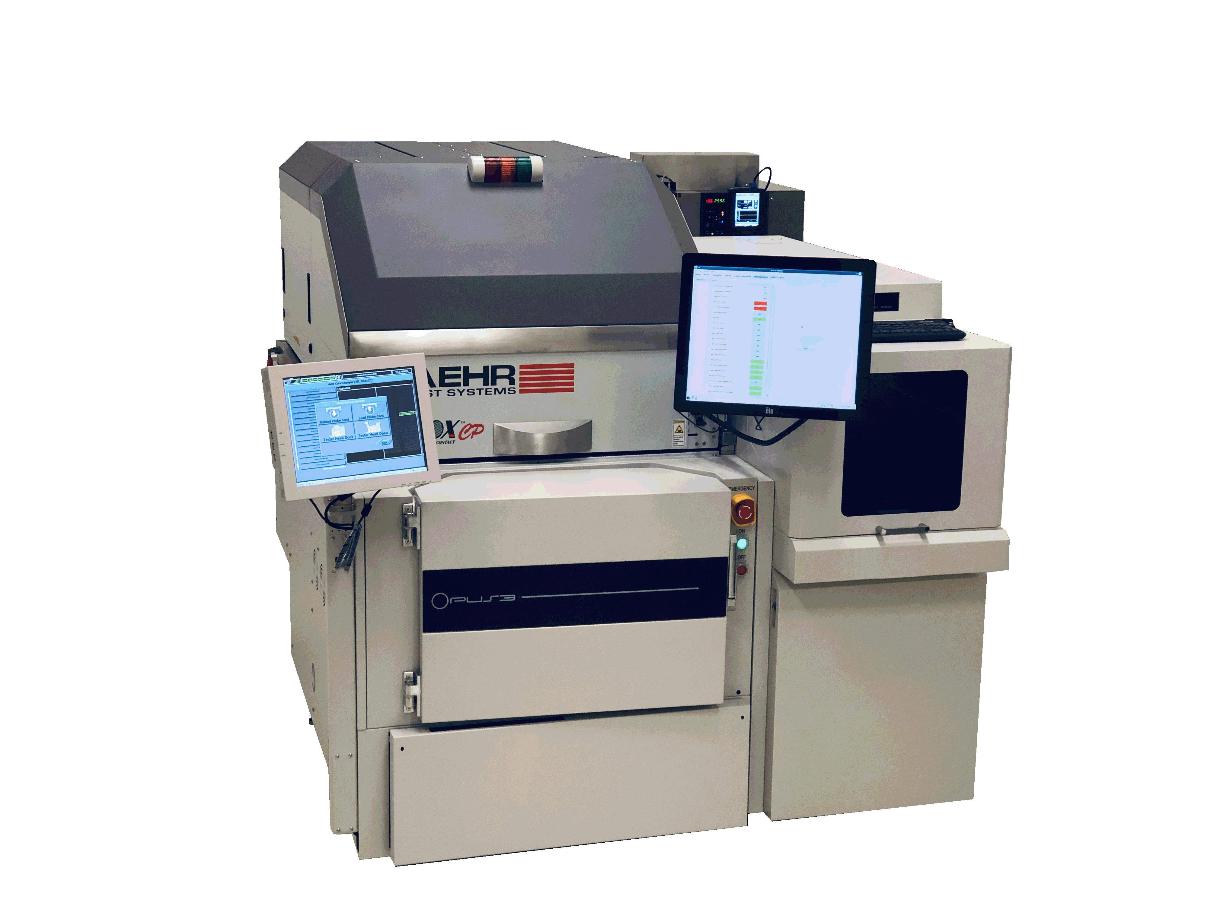
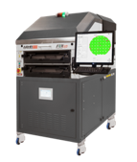



FOX Family of Test & Burn-In Systems
Wafer Level & Singulated Die Solutions for Engineering through Production
Multi-Wafer & Singulated Die
Test & Burn-In Systems
Single Wafer
Test & Burn-In Systems
Engineering & NPI
Test & Burn-In Systems
FOX-P WaferPak & DiePak Contactors
Notes:
P&T p. 4

Slide 8
Customer Momentum and Opportunities
Recent Customer Momentum
New Customer & Market Opportunities
Major new customer for very high-volume devices in data center on Aehr proprietary WLBI
Top three semiconductor company significantly expanding silicon photonics production capacity with Aehr FOX-XP and recently introduced FOX-NP systems
Three new customer wins in silicon photonics test and burn-in with FOX-NP will move to high volume with FOX-XP
First new customer win in silicon carbide using FOX-XP for HVM WLBI
Major mobile supplier purchases DiePaks for installed base of FOX-XPs
Aehr engaged in over two dozen new customer applications for wafer level and singulated die test and burn-in with new FOX-P line of solutions
Multiple silicon photonics and 5G communication infrastructure and data center devices
Data storage devices
Automotive devices including EV control and sensors for ADAS and autonomous vehicles
3D and 2D mobile sensors test & burn-in
Memory device WLBI represents significant upside opportunity

Slide 9

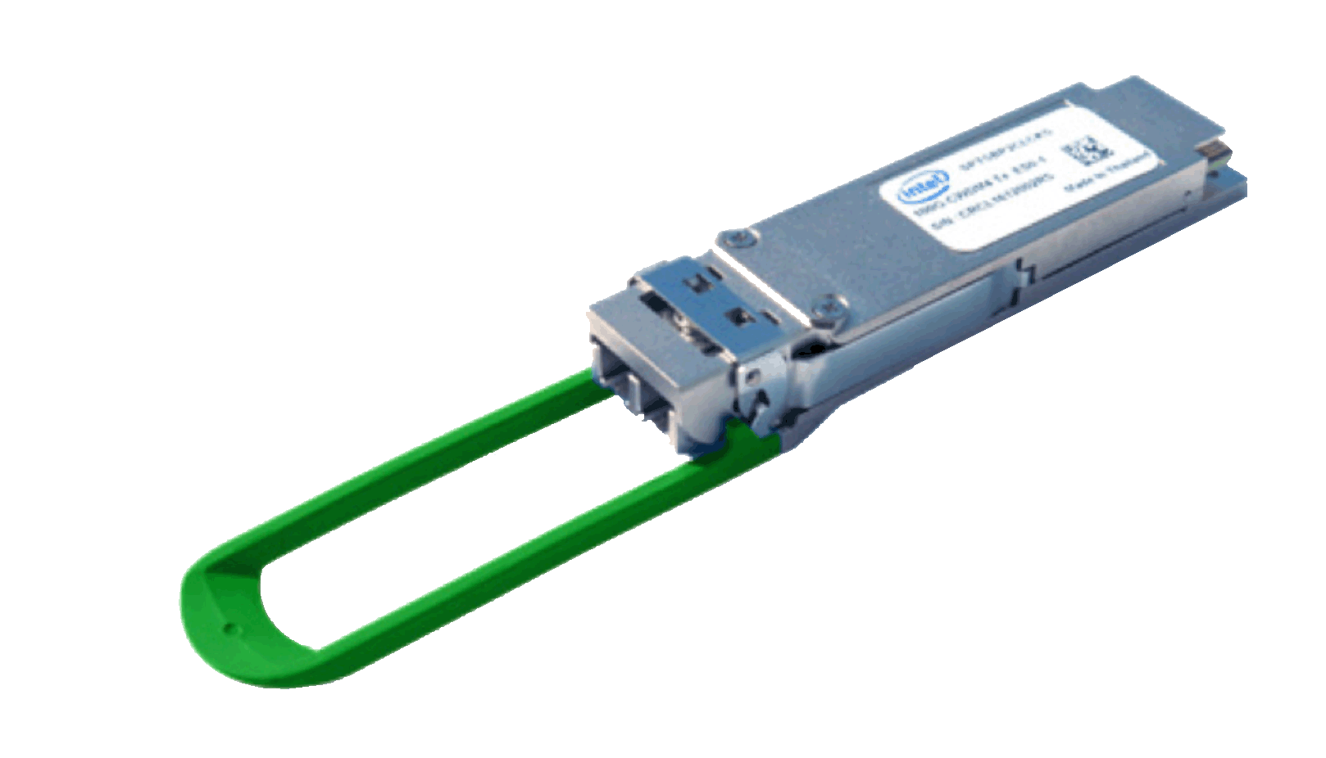



Market Drivers
Need for cost-efficient wafer level and singulated die burn-in & testing as well as new requirements in package part burn in are creating significant revenue opportunities in the following key markets
Data Center Infrastructure and unstoppable growth in Data Storage
Worldwide 5G Infrastructure build out using Silicon Photonics fiber optic transceivers
Automotive IC growth in motor control and power management using Silicon Carbide & IGBT devices, sensors, control, information, and entertainment
3D and 2D Sensors including facial recognition in smartphones, tablets, and other applications
Heterogeneous Integration of semiconductors and 3D fabrication and stacking driving technology and cost roadmaps pushing known good die with test and burn-in of device in wafer form prior to packaging

Slide 10
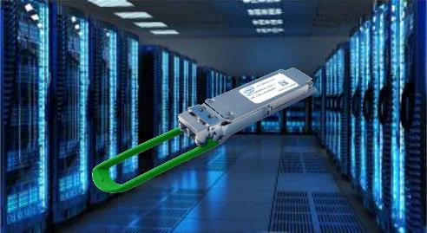
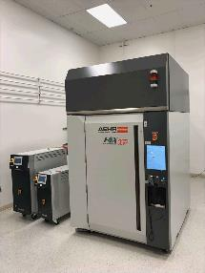
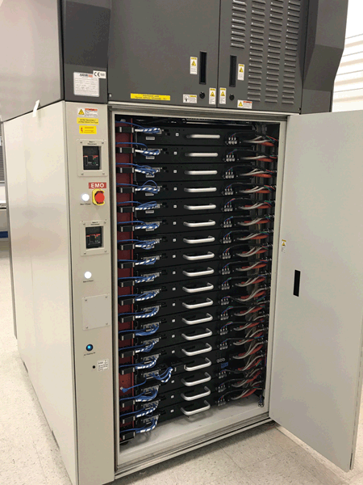

Silicon Photonics
Integrated laser devices directly on silicon transceiver drastically lowering the cost of fiber optic transceivers for data centers and the internet cloud are driving a new requirement and opportunity for wafer level and singulated die burn-in and test
Silicon Photonics growth driven by data centers, sensors, and optical switches
Aehr has five customers in Silicon Photonics worldwide and is engaged with over 15 companies in this space

Slide 11
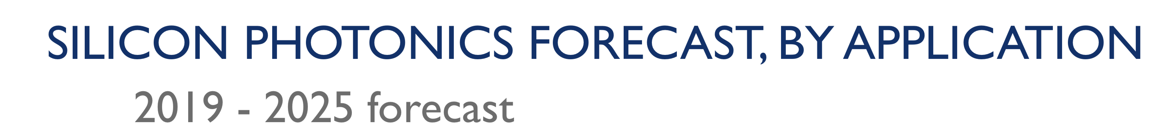
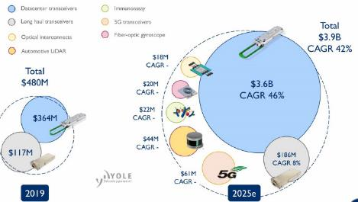
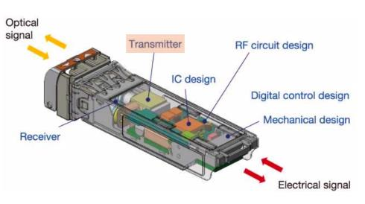
Silicon Photonics Stabilization & Infant Mortality
Silicon Photonics Market Opportunity
Silicon photonics provides wafer level integration and HVM scale -> disruptive cost advantage over discrete fiber optic transceivers
Wafer Level and Singulated Die/Module level Stabilization & Burn-in not only the most cost effective, but is considered an ENABLING capability to scale to HVM and low cost
Aehr is unique in our ability to contact 100% of the lasers on a wafer, drive Die with individual constant current drivers, and manage the thermal load of wafers with as much as 2kW load
Silicon Photonics growth driven by data centers, telecom, & 5G

Slide 12
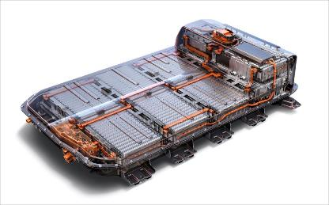
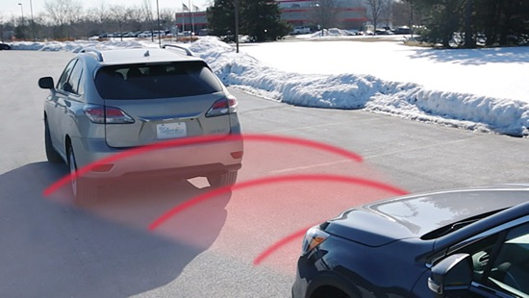

Automotive & EV Semiconductor Device Market
Automotive IC growth in sensors, control, information, and entertainment has substantially higher requirements for initial quality and long-term reliability
New high bandgap / high voltage semiconductors (like Silicon Carbide and Gallium Nitride) create new opportunities in test and burn in.
Collision Detection
Autonomous / Driver Assistance
EV / HEV Power Management
Notes:
IP p. 19

Slide 13

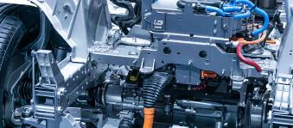
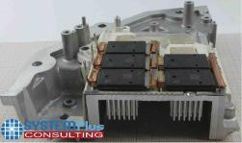
Silicon Carbide and EV/HEV Module Market
High Voltage / Power Electric Automobile powertrains driving high bandgap Silicon Carbide semiconductors with substantially higher initial quality and long-term reliability than current processes support drives burn-in
Silicon Carbide is known in the industry to have very high defect density and high infant mortality related to high voltage break down failure – defect density drives up to 50% initial yield loss and 5% or more yield loss during BI
Plug in Automotive Power Conversion
Electric Vehicle Powertrains
Tesla Model 3 Inverter with ST SiC Power Modules

Slide 14
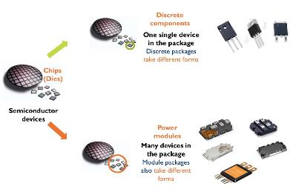
Silicon Carbide Infant Mortality Market
Silicon Carbide Market Opportunity
Silicon carbide wafers have very high defect density with low initial yield and high infant mortality (recognized industry wide)
Devices must by burned in at high temperatures to remove infant mortality for 48 - 100 hours
Wafer Level Burn-in allows removal of bad die PRIOR to packaging in the module with other die
Two types of stress / BI tests drive different configurations. We have introduced a solution for one of the two stress conditions with our FOX systems which works for our current customers and are in the process of prototyping the other with customer feedback. In addition to capturing the WLBI opportunity, we are introducing the new MAX5 system for discrete and other applications where package part burn in is preferable.
Silicon Carbide Die Packaging
Notes:
IP p. 16

Slide 15
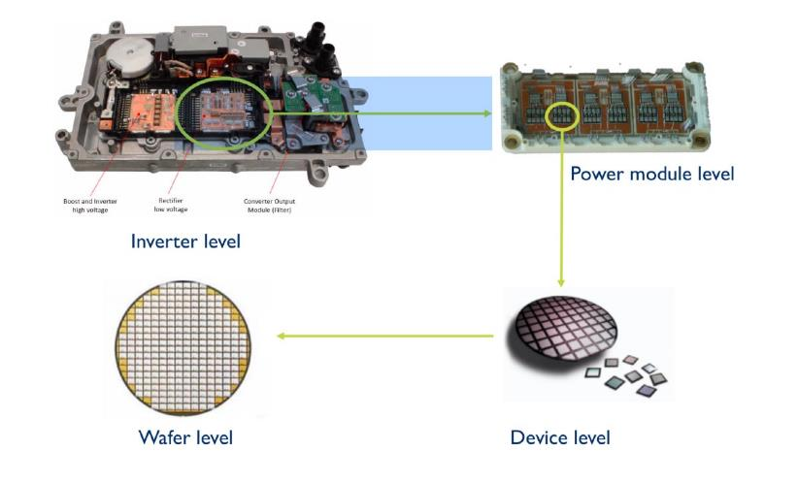
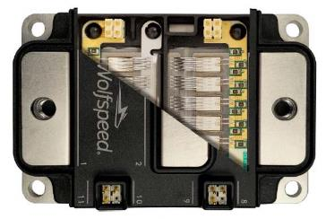
Burn-in at Module is Very Expensive on Yield
Silicon Carbide Module with 8 Die
Customers driving to move Silicon Carbide burn-in to Wafer Level

Slide 16
$1B Market Opportunity for AEHR
  2019 Packaged Part Burn in Systems Market: $218M
  2019 Packaged Part Burn-in Consumables Market: $540M
  Estimated 2021 Wafer Level and Singulated Die Burn-in Systems, Consumables, and Material Handlers Market: $400M+
  Packaged Part Burn in TAM source: VLSI Research May 2020
  Wafer Level Burn-In Equipment TAMs based on VLSI Research, Yole Development, and Aehr actual customer data models

Slide 17
Key Takeaways
  Pioneer of next generation technology platform for wafer level testing
  Significant need for lower cost wafer level test / burn-in
  Wafer level and singulated die test / burn-in being adopted by across multiple high-growth markets including Silicon Photonics and Silicon Carbide
  Over two dozen new customer engagements for wafer level test / burn-in
  Growing, high margin consumables revenue
  $1B+ market opportunity
  Packaged Part Burn in TAM source: VLSI Research May 2020
  Wafer Level Burn-In Equipment TAMs based on VLSI Research, Yole Development, and Aehr actual customer data models

Slide 18
Setting the Test Standard for Tomorrow
Setting the Test Standard for Tomorrow
Nasdaq: AEHR
Nasdaq: AEHR

